Slide 1

MAJOR PROJECT
OF
BACHELOR OF TECHNOLOGY
IN
COMPUTER SCIENCE & ENGINEERING
Submitted By
HIMANSHI KHOWAL SAVEEN YADAV
Roll No: 4865297 Roll No: 4865312
GLOBAL INSTITUTE OF TECHNOLOGY & MANAGEMENT

Slide 2
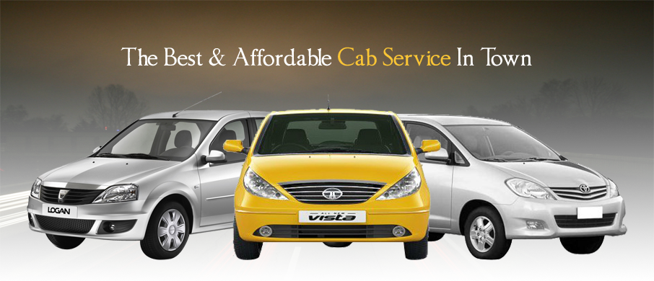
EASY CAB BOOKING

Slide 3
INTRODUCTION
Now,one can easily plan the journey comfortably as the process is efficient and fast with being easy to access. Bookings can be made through the Easy Cab site or by the phone call. This being a big step in terms of improvement in the Taxi system it is widely accepted across the country.
A route-based booking system that facilitates the issue of journey-cum-booking Taxi, which can be issued from any station to any station.
Passenger journey to multiple laps of booking can be handled from a single terminal window.
The booking facility is offered round-the-clock (24 hours uninterrupted).
Changes in Taxi profiles (Taxi addition, replacement, de-allocation), route structures, etc., can be made effective immediately with the appropriate contingency handling.

Slide 4
Main Objectives are:-
The fare must be economical so that it is in reach/budget of every person.
Taxi must reach on time on the defined destination.
There must be a large fleet of Taxis.
Provide the functionality to make your own bookings.
Provide the customer with taxi availability.
Engage your customers through interaction such as feedback forms.
Easy payment facility must be provided website Debit card or Credit Card.
Payment bill must be provided by Taxi driver.

Slide 5
PURPOSE OF THE PROJECT:
The purpose of this project is to develop one Easy Cab Booking process for all taxi services. Improve client experience with ordering of placement services. The main aim of this is to maintain the Cab Booking system using web forms to reduce the paper and printing and distribution work. It also includes managing your cab company requirement and monitoring your booking system. It provides a very friendly environment for both customer and admin which improve efficiency of order processing.

Slide 6
PROJECT SCOPE
Easy Cab service is a major transport service provided by the various transport operators in a particular city. Mostly people use Taxi service for their daily transportational need. The company must be registered and fulfill all the requirements and security standards set by the transport department. Easy Cab Software is a web based platform that allows all the customers to book their taxi’s and executive taxi's (such as Limousines) all online from the comfort of their own home or office. The platform should offer an administration interface where the taxi company can manage the content, and access all bookings and customer information. The platform will include all the required functionality such as hosting, email accounts, updates, a domain name (the web address) and most importantly backups.

Slide 7
Advantages:
Very fast and accurate.
No need of any extra manual effort.
No fear of data loss.
Just need a little knowledge to operate the system.
Improve efficiency of placement processing, so that every request, internal and external vacancy can be tracked from start to finish.
Improve Cab Service.

Slide 8
Module Description
Well structured designs improve the maintainability of a system. A structured system is one that is developed from the top down and modular, that is, broken down into manageable components. In this project we modularized the system so that they have minimal effect on each other.
This application is designed into five independent modules which take care of different tasks efficiently.
Customer Module
Admin Module.
View Module.
Database Operations Module.
Add Module
Delete Module
Modify Module
View Module

Slide 9
MODULE DESCRIPTION
Module 1: Password Module
In this module, registered user enters a password and the software checks its validity. If the password is valid then he is allowed to enter, otherwise “Invalid’’
Module 2: User Registration Module
In this module user can submit his details. After submitting his details, he/she will be easily ready for the interview.
Module 3: Booking Report Module
In this module, registered user can easily see his/her details by logging into their account and book the cab.
Module 4:AckonwlgementModule
In this module, the acknowledgement of the registration is to be seen by the customer.
Module 5: Login Module
In this module user login’s with registered user id or password.

Slide 10
SOFTWARE AND HARDWARWE SPECIFICATION
Hard ware Specification:
Processor : Intel P-III based system
Processor Speed : 250 MHz to 833MHz
RAM : 64MB to 256MB
Hard Disk : 2GB to 30GB
Software Specification:
Language : PHP Wamp Server
Database : My Sql 5.0
Operating System : Any Operating System.

Slide 11
INTRODUCTION TO PHP
PHP is a server-side scripting language created in 1995 and designed for web development but also used as a general-purpose programming language. As of January 2013, PHP was installed on more than 240 million websites (39% of those sampled) and 2.1 million web servers. Originally created by Rasmus Lerdorf in 1994, the reference implementation of PHP (powered by the Zend Engine) is now produced by the PHP group. While PHP originally stood for Personal Home Page, it now stands for PHP: Hypertext Preprocessor, which is a recursive backronym.
PHP code can be simply mixed with HTML code, or it can be used in combination with various templating engines and web frameworks. PHP code is usually processed by a PHP interpreter, which is usually implemented as a web server's native module or a Common Gateway Interface (CGI) executable. After the PHP code is interpreted and executed, the web server sends resulting output to its client, usually in form of a part of the generated web page; for example, PHP code can generate a web page's HTML code, an image, or some other data. PHP has also evolved to include a command-line interface (CLI) capability and can be used instandalone graphical applications.

Slide 12
Features of PHP
Simple
Secure
Portable
Object-oriented
Robust
Multithreaded
Architecture-neutral
Interpreted
High Performance
Distributed & Dynamic

Slide 13
OBJECT-ORIENTED PROGRAMMING CONCEPT
What Is an Object?
An object is a software bundle of variables and related methods. Software objects are often used to model real-world objects you find in everyday life.
What Are Messages?
Software objects interact and communicate with each other using messages.
What Are Classes?
A class is a blueprint or prototype that defines the variables and the methods common to all objects of a certain kind.
What Is Inheritance?
A class inherits state and behavior from its super class. Inheritance provides a powerful and natural mechanism for organizing and structuring software programs.

Slide 14
DATAFLOW DIAGRAMS (DFD)
The data flow diagram is used for classifying system requirements to major transformation that will become programs in system design. This is starting point of the design phase that functionally decomposes the required specifications down to the lower level of details. It consists of a series of bubbles joined together by lines.
Bubbles: Represent the data transformations.
Lines: Represents the logic flow of data.
Data can trigger events and can be processed to useful information. System analysis recognizes the central goal of data in organizations. This dataflow analysis tells a great deal about organization objectives are accomplished.

Slide 15
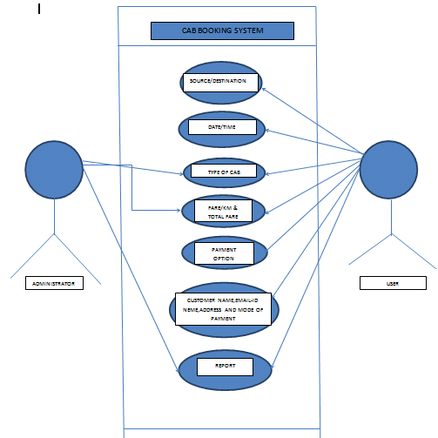
Use Case Diagram

Slide 16
NOTATIONS USED IN DATA FLOW DIAGRAMS
The logic dataflow diagrams can be drawn using only four simple notations i.e., special symbols or icons and the annotation that associates them with a specific system. Since the choice of notation we follow, does not affect impede or catalyze the system process; we used three symbols from YOURDON notation and one from Gain and Sarson notation as specified below.
Element References symbols
Data Flow Process
Process
Data Store

Slide 17
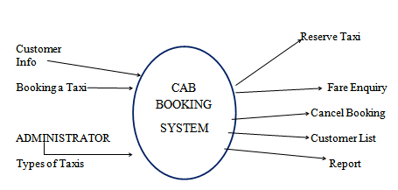
0 ‘ level DFD (Company Placement System)

Slide 18
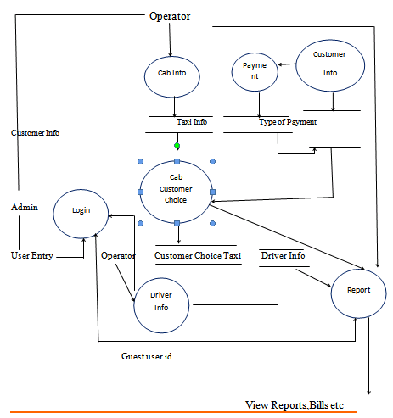
1‘ level DFD (Company Placement System)

Slide 19
DATA BASE DESIGN OR TABLES
Fare table
Booking table
Resiter table

Slide 20
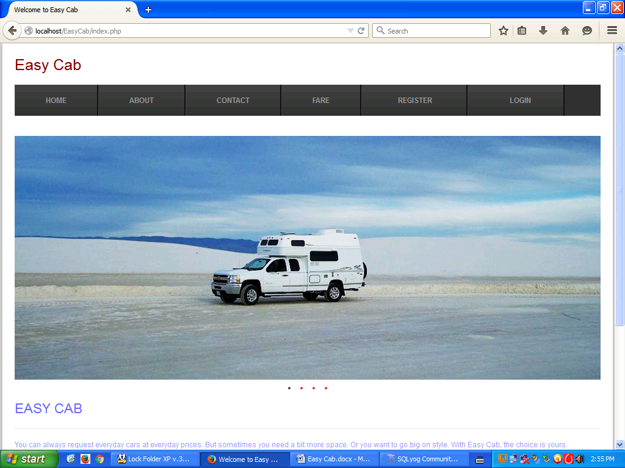
SCREEN SHORT

Slide 21
CONCLUSION
The aim of this project is to develop one Easy Cab Booking processes for all taxi services. Improve client experience with ordering of placement services. The main aim of this is to maintain the Cab Booking system using web forms to reduce the paper and printing and distribution work. It also includes manage your cab company requirement, monitor your booking, system. It provides a very friendly environment for both customer and admin which improve efficiency of order processing.
In future, we can have the SMS facility for the employees and employee search engine that can provide the result on the basis of different criteria to search. We can also have one more module of implementing this project on web.

Slide 22
BIBLIOGRAPHY
www.google.com
https://en.wikipedia.org/wiki/PHP
http://www.w3schools.com/php/php_intro.asp
https://en.wikipedia.org/wiki/Feasibility_study
https://www.extension.iastate.edu/agdm/wholefarm/html/c5-65.html

Slide 23


